Slide 1
DS Course Design Ecosphere
杨浩斌 202030430240 (group leader)
赵旻昆 202030430394
张恭利 202030430271
陈冠宇 202030430042

Slide 2
Language: C#
UI Framework: WPF
Total Codes: 6500 lines

Slide 3
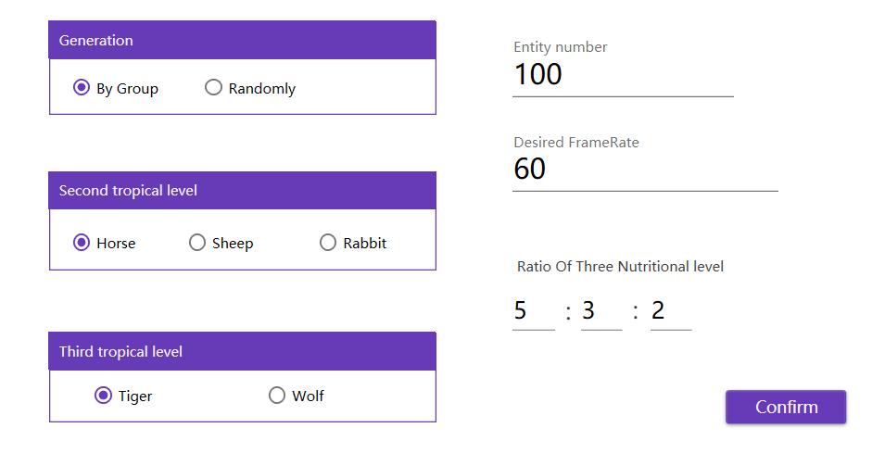


Slide 4
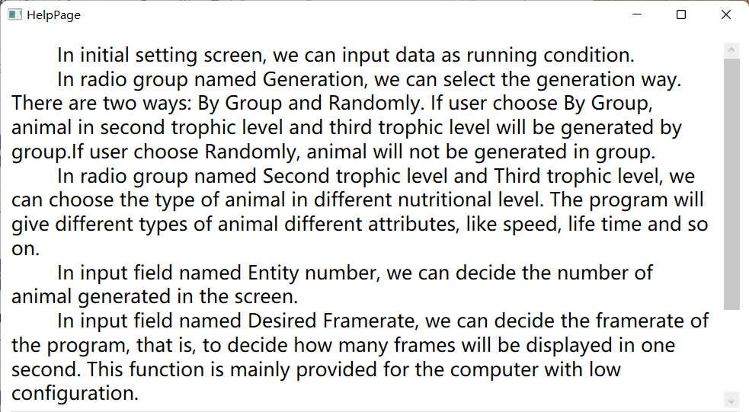

Slide 5
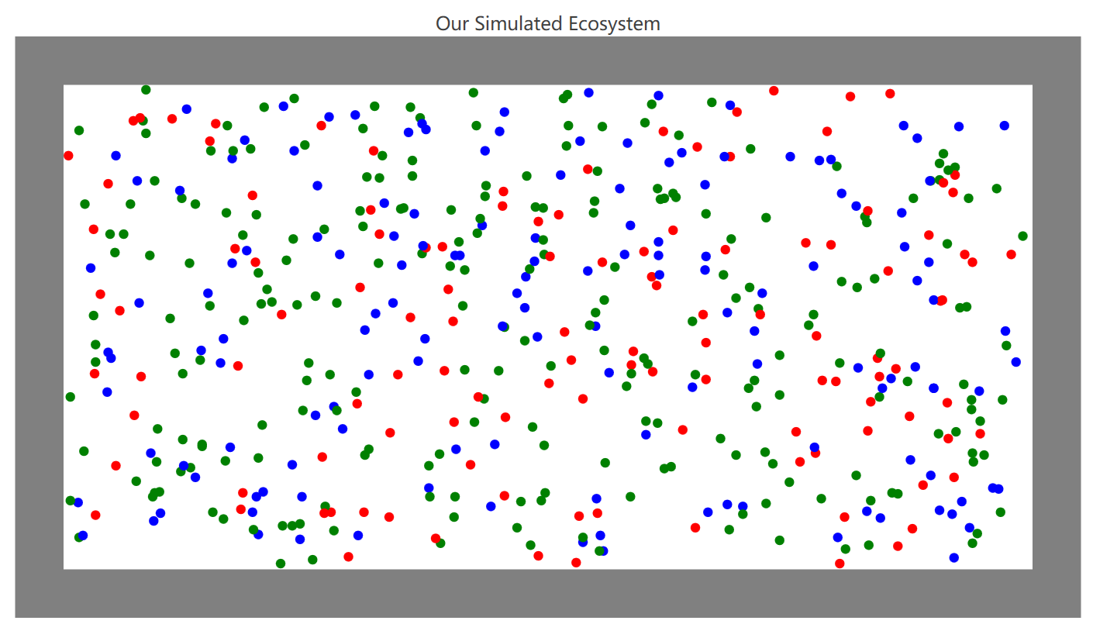


Slide 6
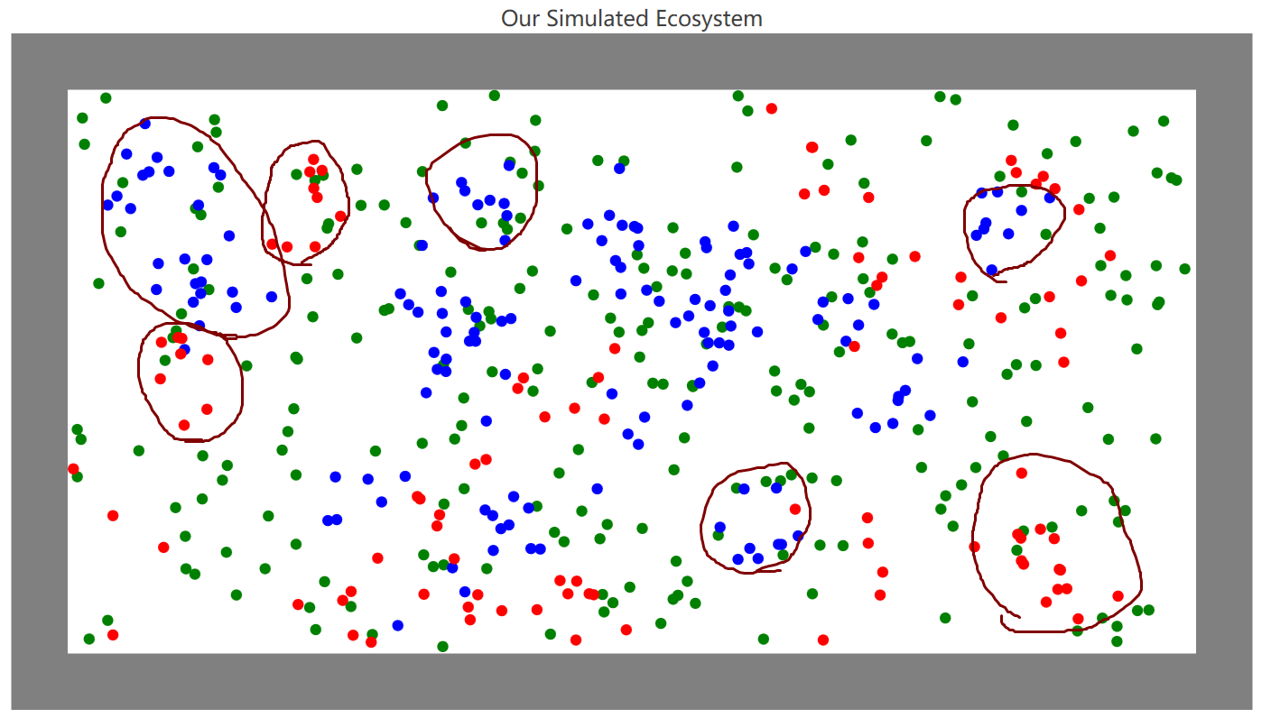


Slide 7
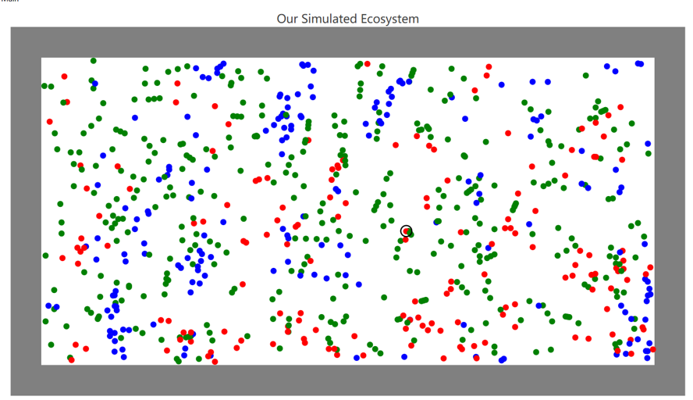
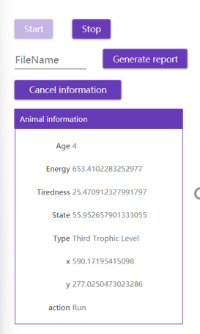


Slide 8
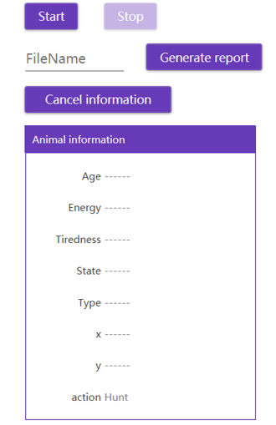
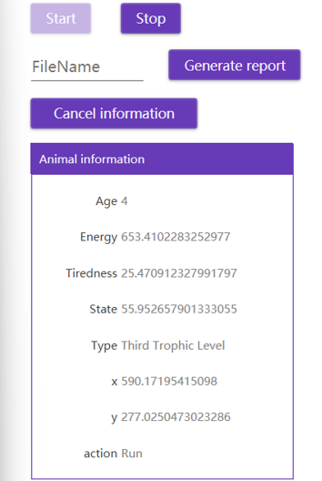

Slide 9
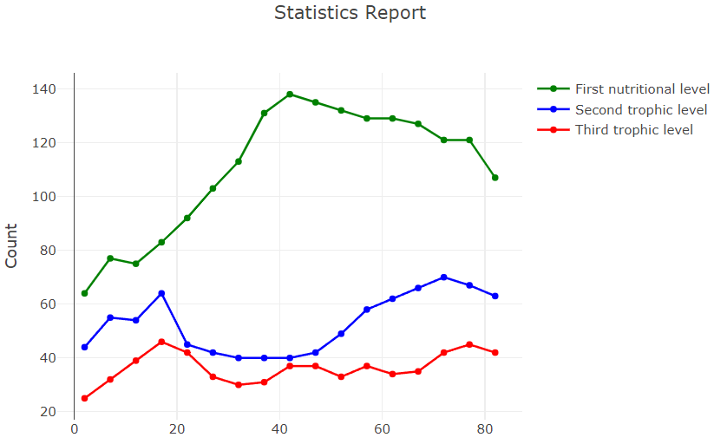


Slide 10
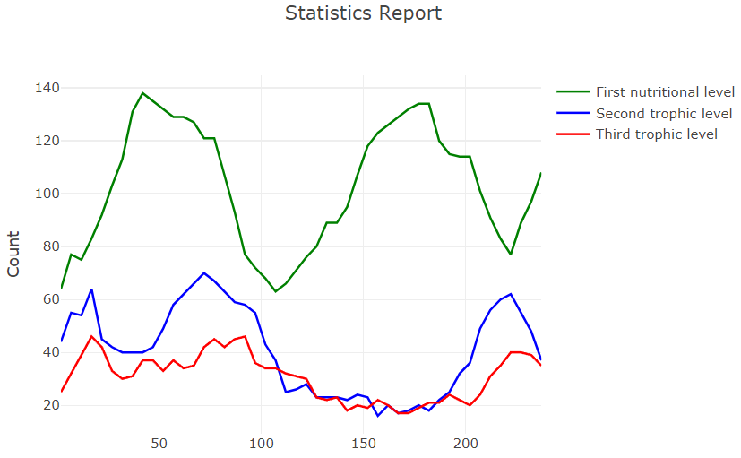

Slide 11
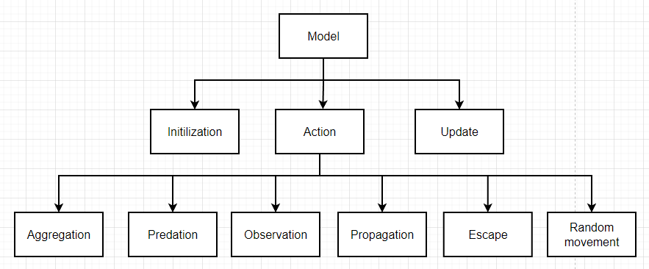

Slide 12
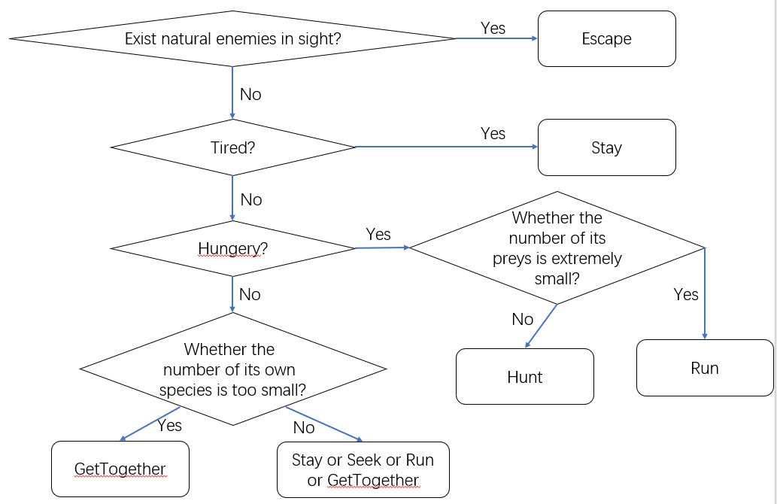
Animals’ Actions
Escape
Stay
Hunt
Run
GetTogether
Seek

Slide 13
Relation between Data Structure
List
Dictionary
Struct
Priority Queue
General Tree

Slide 14
Priority Queue (Min Heap)
Key Methods
Push() | Push the new element to the queue
Empty() | Check whether the queue is empty
Pop() | Get the first element in the queue and delete it
Top() | Get the first element in the queue
SiftUp() | Construct the min heap so that the elements are arranged in order from bottom to top
SiftDown() | Construct the min heap so that the elements are arranged in order from top to bottom
The min heap used in our data structure is encapsulated. The Push function will put the new element into the heap, and use the Shift Up function to rebuild the min heap according to the sorting rules. The Pop function will get the first element in the heap and delete it. The purpose of this data structure is o store all the edges constructed by two entities with the distance between them smaller to the given radius. The edge with shorter distance will have higher priority.

Slide 15
General Tree
This data structure we have learned in our class. It is mainly used to generate a tree structure with more than 2 child nodes and encapsulated by array. Each position in the array stores the root node of the tree to which the element belongs to. The Find function returns the root of the tree to which the element belongs to. The Differ function determines whether two elements belong to the same tree. The Union function adds two elements to the same tree. The purpose of the data structure is to justify whether two entities are in the same group (If so, these two entities will be attached to the same tree. )
Key Methods
Find() | Find the root of the tree to which the element belongs to
Differ() | Determines whether two elements belong to the same tree.
Union() | Add two elements to the same tree

Slide 16
Most challenging parts of our project
It is hard to solve the problem that when the number of animals is very large, the program will run slowly and even crash.
It is hard to make sure that our ecosystem can keep relatively stable for a long time.
It is hard to realize the clustering algorithm and propagating mechanism appropriately (including selecting the suitable data structures).

Slide 17
It’s time to show our demo!

